Slide 1

INSURANCE FRAUD DETECTION USING MACHINE LEARNING
REVIEW 2 Under the guidance of Prof. T. Ramesh - Asst Prof CSE Presented by Mr. Syed Atif 20171CSE0702 Mr. Syed Shoaib 20171CSE0709 Mr. Tejas Bhatnagar 20171CSE0721 Mr. Thanuj Kumar S 20171CSE0726 Mr. Utsav Deep 20171CSE0734
PRESIDENCY UNIVERSITY

Slide 2
Work done so far
Exploratory Data Analysis
Clustering
Building ML models
Model Evaluation
Model Selection
Work under process
Table
of
Contents

Slide 3
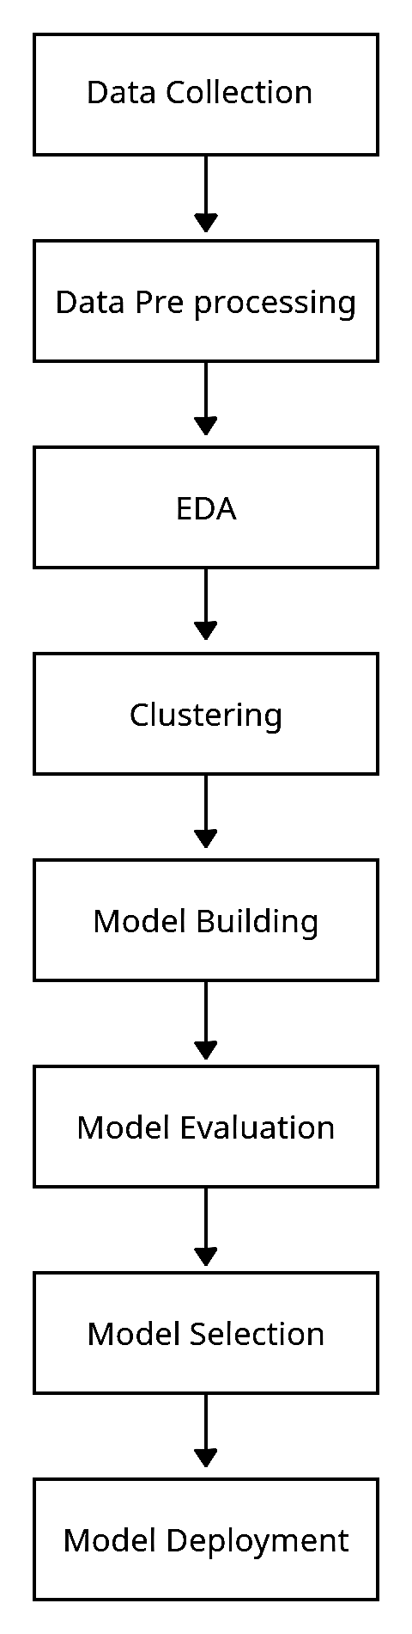
Work Done So Far
Done with Literature survey​​ (Review 1)
Done with specification and requirements study ​​(Review 1)
Designed system flow diagram ​​(Review 1)
Collected the required dataset ​​(Review 1)
Data preprocessing (Review 1)
Exploratory Data Analysis (Review 2)
Splitted the Dataset by Applying clustering algorithm (Review 2)
Building ML models (Review 2)
Evaluating and Selecting best model for prediction (Review 2)

Slide 4
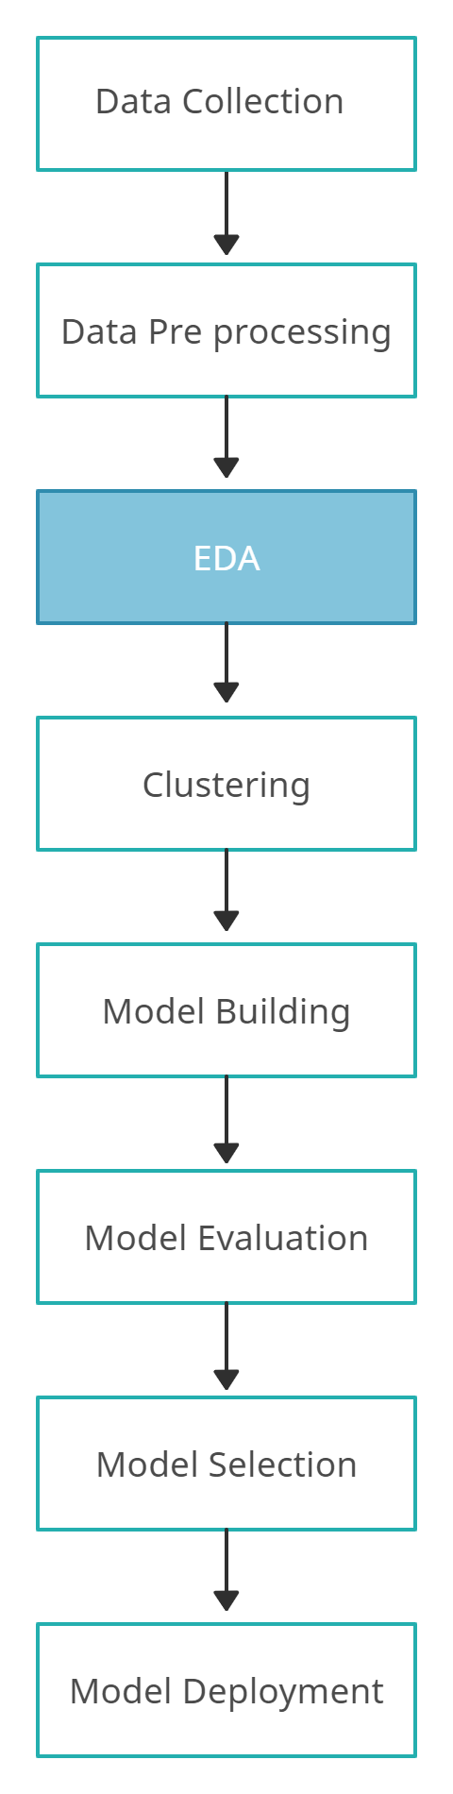
Exploratory Data Analysis
Exploratory Data Analysis refers to the critical process of performing initial investigations on data so as to discover patterns, to spot anomalies, to test hypothesis and to check assumptions with the help of summary statistics and graphical representations.
It is a good practice to understand the data first and try to gather as many insights from it.

Slide 5
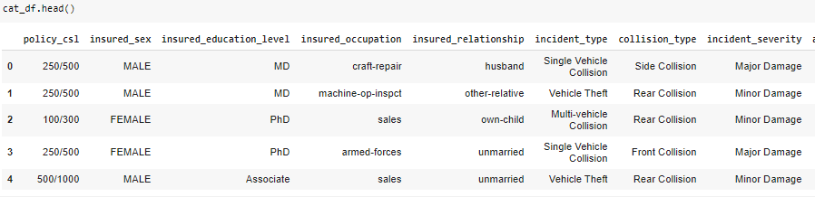
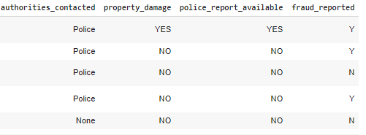
First 5 rows of the data set

Slide 6
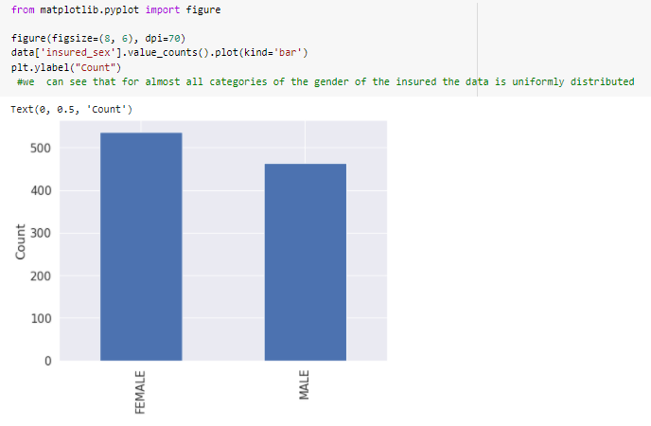
We can see that for almost all categories of the gender of the insured the data is uniformly distributed

Slide 7
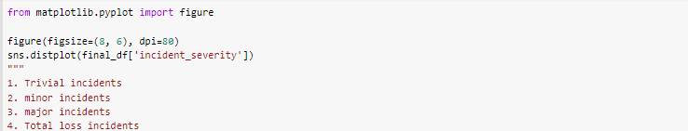
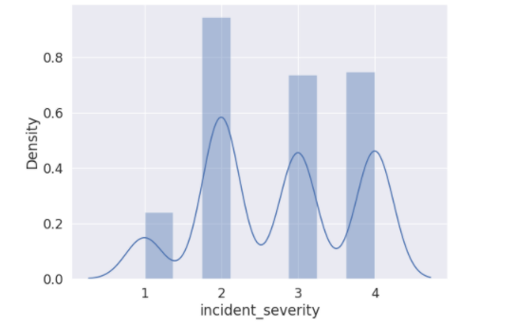
We can see that there are least claims for trivial incidents, most claims for minor incidents and for major and total loss incidents the claims are almost equal.

Slide 8
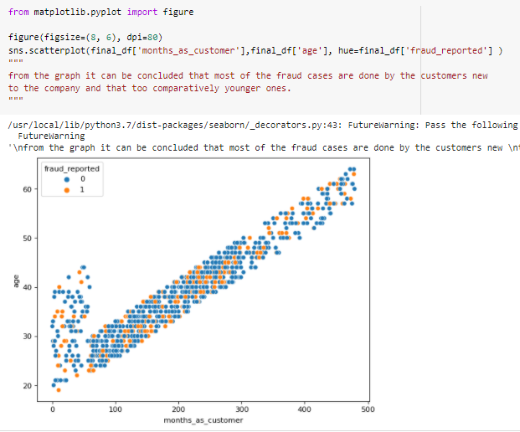
From the graph it can be seen that most of the fraud cases are done by the customers new to the company and that too comparatively younger ones

Slide 9
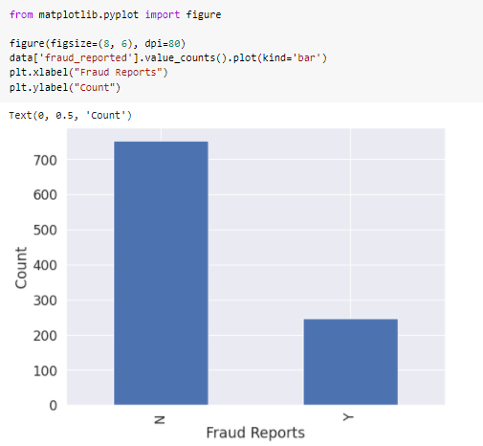
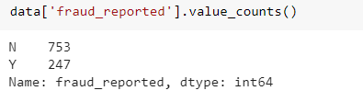

Slide 10
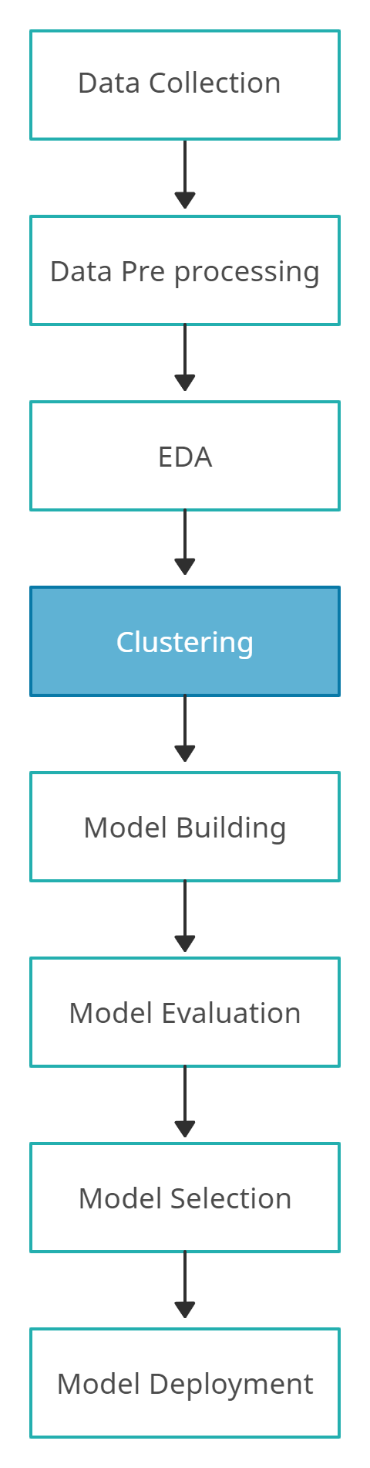
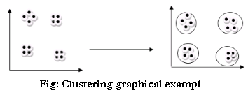
Clustering
Grouping set of documents into subsets or clusters.
The goal of the algorithm is:
To create clusters that are coherent internally, but clearly different from each other

Slide 11
K-Means Clustering
k-means clustering is an algorithm to classify or to group the objects based on attributes/features into K number of group.
The grouping is done by minimizing the sum of squares of distances between data and the corresponding cluster centroid

Slide 12
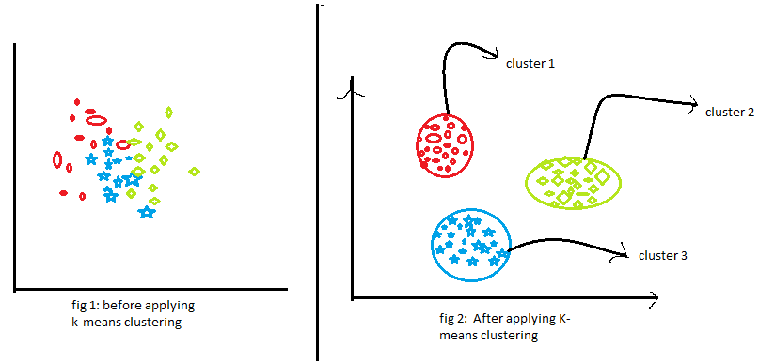
K-Means Clustering

Slide 13
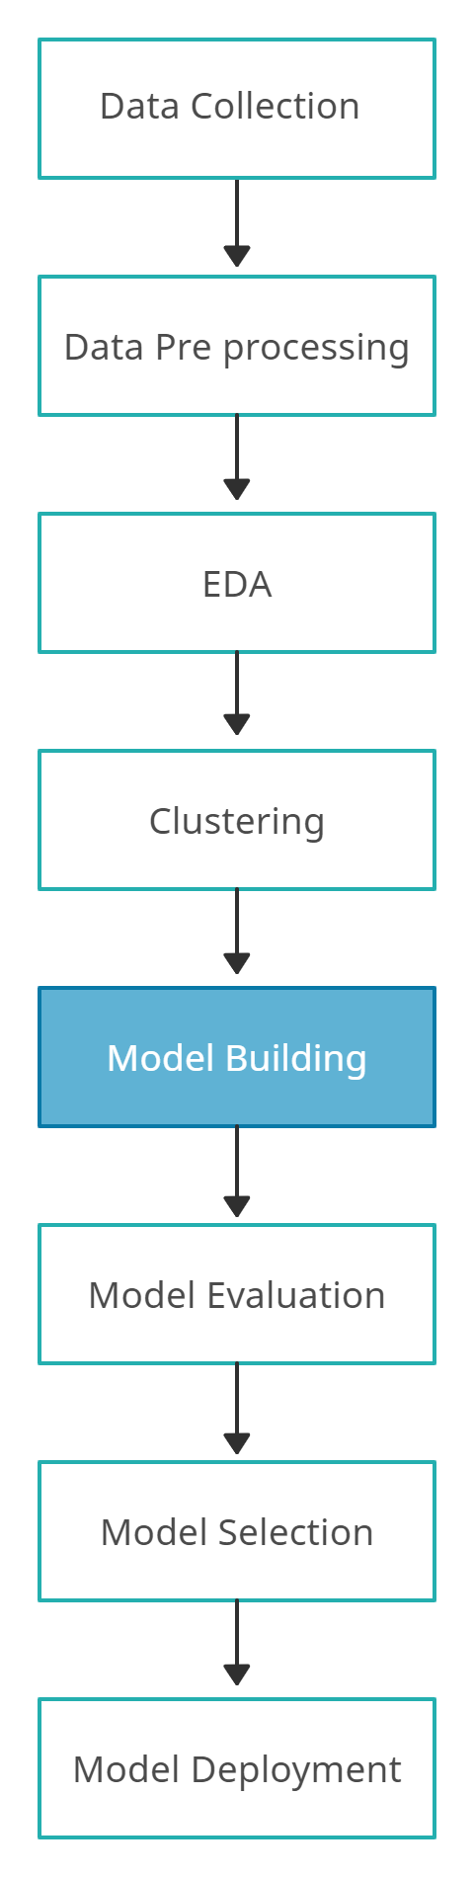
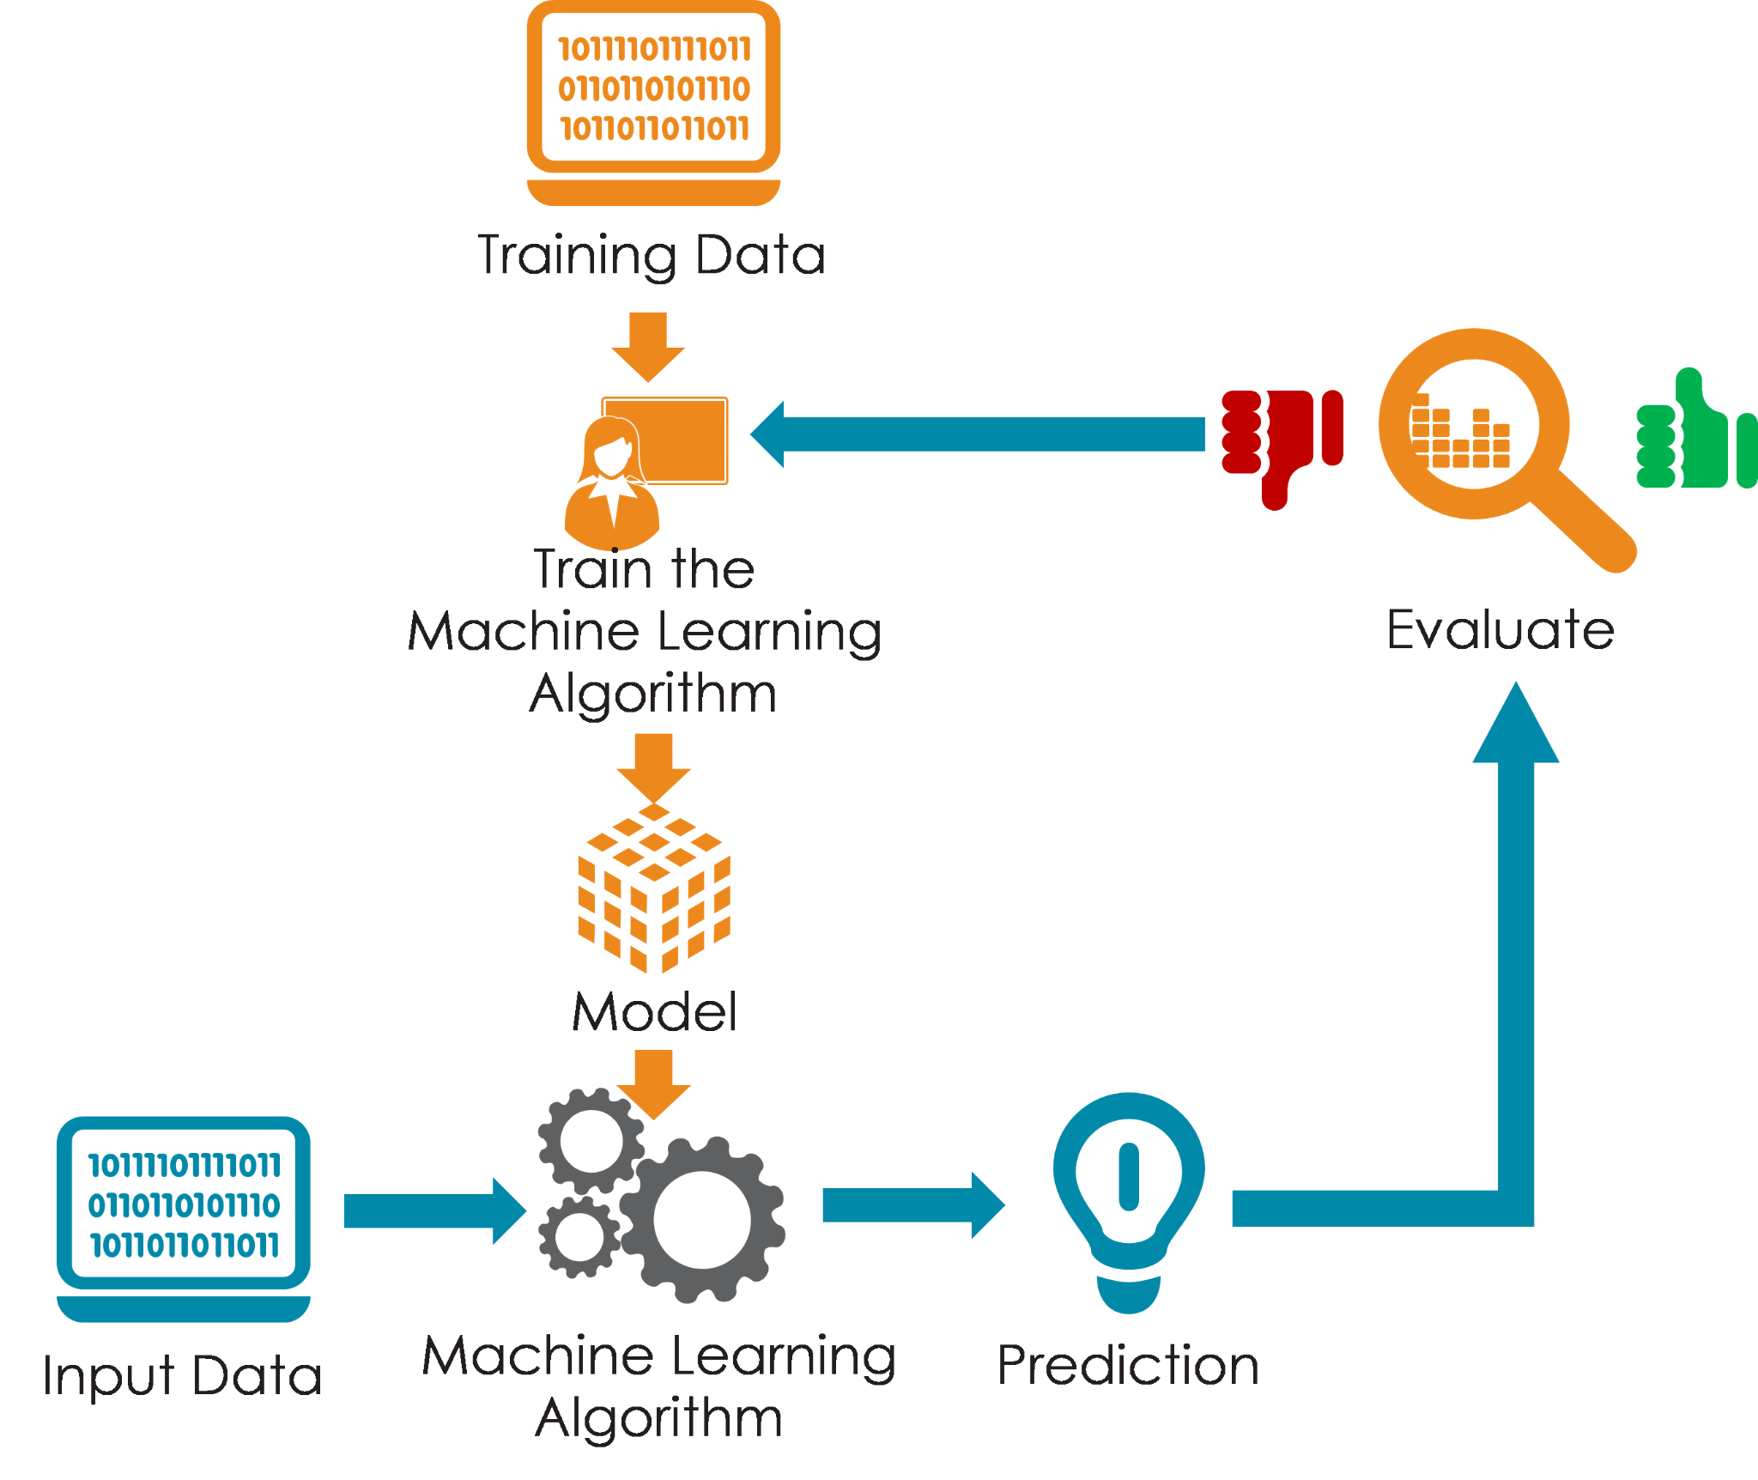
Model Building

Slide 14
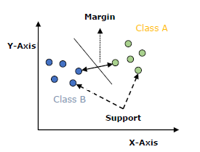
Support Vector
Machine
Support vectors are the data points that lie closest to the decision surface (or hyperplane)
It is a decision plane or space which is divided between a set of objects having different classes.

Slide 15
Support Vector
Machine
The main goal of SVM is to divide the datasets into classes to find a maximum marginal hyperplane (MMH)
SVM will generate hyperplanes iteratively that segregates the classes in best way.
It will choose the hyperplane that separates the classes correctly.

Slide 16
XGBoost
XGBoost is a decision-tree-based
ensemble Machine Learning algorithm that uses a gradient boosting framework..
XGBoost approaches the process of sequential tree building using parallelized implementation
XGBoost naturally admits sparse features for inputs by automatically ‘learning’ best missing value depending on training loss and handles different types of patterns in the data more efficiently.

Slide 17
XGBoost
XGBoost is a popular and efficient open-source implementation of the gradient boosted trees algorithm.
When using gradient boosting for regression, the weak learners are regression trees, and each regression tree maps an input data point to one of its leafs that contains a continuous score
The algorithm comes with built-in cross-validation method at each iteration, taking away the need to explicitly program.

Slide 18
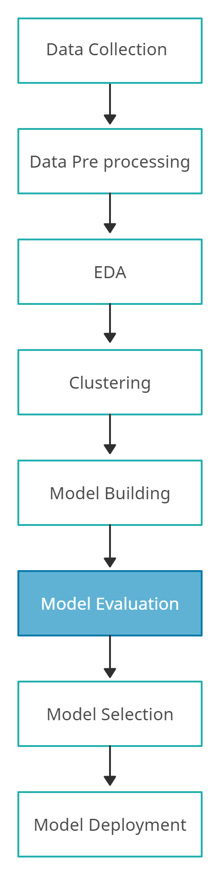
After the clusters have been created, we find the best model for each cluster.
We are using two algorithms, “SVM” and "XGBoost". For each cluster, both the algorithms are passed with the best parameters derived from GridSearch.
We drive confusion matrix and calculate accuracy scores.
We calculate the TPR, TNR, FNR, FPR, AUC scores for both models and select the model with the best score.
Model Evaluation

Slide 19
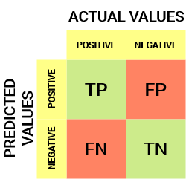
Confusion Matrix
Model Evaluation
Accuracy
Precision
Recall
F1 Score
The target variable has two values: Positive or Negative
The columns represent the actual values of the target variable
The rows represent the predicted values of the target variable

Slide 20
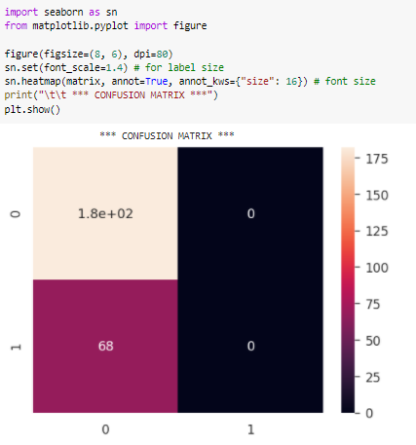
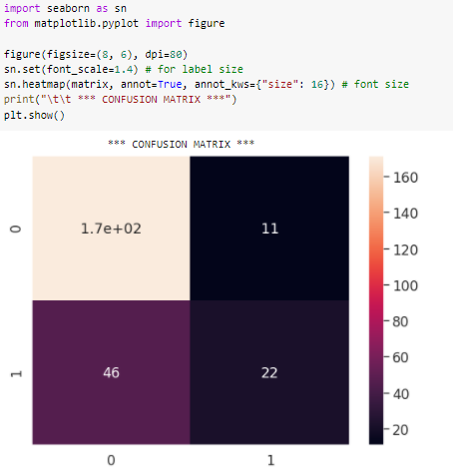
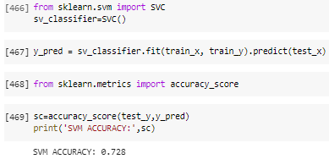
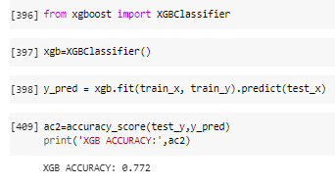
SVM
XGB

Slide 21
Measure | Formula | SVM | XGBoost
Accuracy | TP + TN TP + TN + FN + FP | 0.728 | 0.772
Precision | TP TP + FP | 1.000 | 0.939
Recall | TP TP + FN | 0.000 | 0.323
F1-score | 2 * Prec * Rec (Prec + Rec) | 0.842 | 0.857
Error rate | FP + FN TP + TN + FN + FP | 0.272 | 0.228
AUC | Area under curve | 0.500 | 0.631
Model Evaluation

Slide 22
Measure | Formula | SVM | XGBoost
True Positive Rate | TP/P | 1.000 | 0.939
True Negative Rate | TN/N | 0.000 | 0.323
False Positive Rate | FP/P | 0.370 | 0.252
False Negative Rate | FN/N | 0.000 | 0.161
Model Evaluation

Slide 23
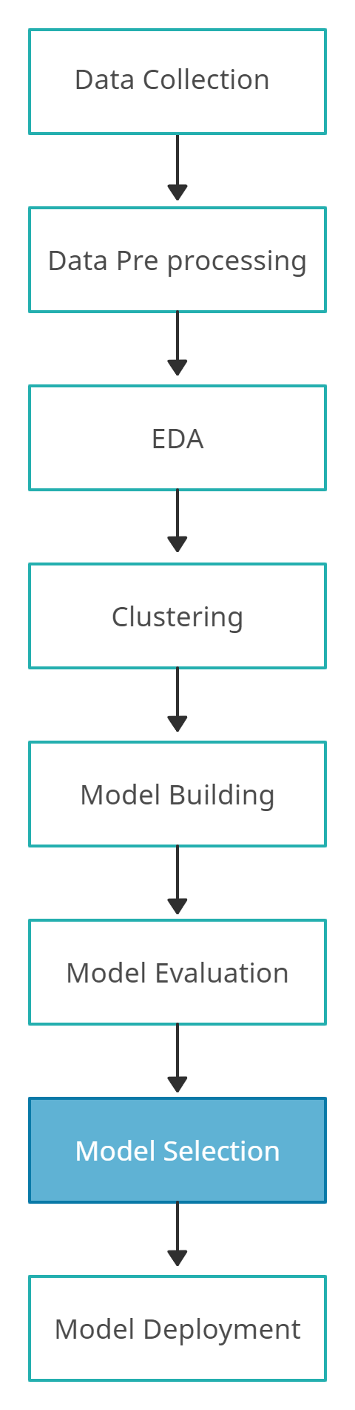
After models are build and undergone evaluation, then models are compared with each other basis of efficiency
Evaluating the models with various evaluating parameters we select the efficient model for prediction which gives accurate results.
In our problem, after demonstrating evaluation process we clearly notice XG Boost is more efficient than SVM
Therefore we can select XG Boost for our Prediction
Model Selection

Slide 24
Model Deployment
Front end development
Deployment to the Cloud
Work
under process

Slide 25
Thank you

